Slide 1

Fighting antibiotic resistance 24/7
Notes:
Ladies and gentlemen,
It is a great pleasure and honour for me to be here today and to speak on this interesting and relevant topic: antibiotic resistance and infection control.

Slide 2
Name & title
Notes:
My name is …… and I am ……
Let me start by introducing Symbiocare-Health by Sweden, a Swedish government and industry initiative founded in 2010.
The Swedish healthcare system is one of the best in the world. We have made great progress in a vast number of areas, from research and innovation to clinical practice and management. We have therefore much to share when it comes to reaching success in health and social care. How come Sweden spends roughlly 10 percent of its GDP on healthcare but still manages to outperform countries with much larger expenditures? This is where Symbiocare - Health by Sweden comes in!

Slide 3

Improving health outcomes through collaboration
Healthcare
Academia
Industry
Notes:
Symbiocare – Health by Sweden sets out to describe our journey in Sweden. In essence our health system is dependent on the symbiosis between care providers, academia and industry. The tradition of collaboration and co-creation is the key to Sweden’s ability to provide world-class care to everyone at an affordable cost.
Our purpose is to promote Swedish health care and life science internationally. We also hope to spur collaboration. We want to learn and share experiences, methods and knowhow globally as we believe collaboration is the key to obtaining world-class care for everyone.
We welcome scientists, industry, investors and societies to come and collaborate with their Swedish counterparts on meeting the global healthcare challenges of today and tomorrow. Through collaboration we can meet the needs of the health system for better and more effective equipment, medical procedures and a smarter health care chain. The system benefits from improved outcomes and safer care at a lower cost.

Slide 4
Sweden’s public health objectives
The overall national objective of health and medical care policy is to create conditions for the entire population to enjoy good health on equal terms
The objective of the Government’s health and medical care policy is to offer needs-adjusted, accessible and effective care.
The long-term objective of the Government's public health policy is to even out health inequalities that are possible to change.
Public health policy should also provide people with tools for improving their own health.
The contents of the Symbiocare-Health by Sweden platform aim to communicate the Swedish point of view in an international context, not necessarily covering all aspects of Sweden´s public health objectives.
Notes:
The overall national objective of health and medical care policy is to create conditions for the entire population to enjoy good health on equal terms:
The objective of the Government’s health and medical care policy is to offer needs-adjusted, accessible and effective care.
The long-term objective of the Government's public health policy is to even out health inequalities that are possible to change.
Public health policy should also provide people with tools for improving their own health.
http://www.government.se/government-policy/public-health/objectives-and-visions-for-public-health-and-health-care/

Slide 5

Modern medicine at stake
Notes:
It is a great pleasure and honour for me to be here today and to speak on this interesting and relevant topic: antibiotic resistance and infection control.
The spread of antibiotic resistance is rapidly becoming a serious threat to public health and health care systems all over the world.
Without effective antibiotics to prevent and treat bacterial infections, the achievements of modern medicine will be jeopardized.
It will be difficult or even impossible to treat even the most common bacterial infections and recovery will be prolonged, leading to increased morbidity and mortality for severely ill patients.
Chemotherapy for cancer, intensive care, care of preterm babies and routine surgical procedures might all be considered too dangerous in the future, due to the high risk of difficult-to-treat infections.

Slide 6

Challenges
Prevent the spread of infections
Rational use of antibiotics
Develop new antibiotics
Notes:
To alter this development, we need to improve in several areas.
We need to prevent the further spread of infections.
We need a rational use of antibiotics.
And we need to develop new antibiotics.

Slide 7

An urgent matter
Notes:
Developing new antibiotics is an urgent matter.
This is primarily because the antibiotics pipeline is starting to run dry.
Secondly, traditional market forces cannot solve this problem. We need to quickly find incentives to foster innovation and new antibiotics.
This is a challenge that requires collaboration on both the national and global level.
In Sweden we have established an approach towards collaboration that has proved effective.

Slide 8
The Swedish approach
Healthcare
Academia
Industry
Notes:
The Swedish approach to antibiotic resistance and infection control is rooted in a long tradition of close collaboration between society, academia and industry.
In 2000 Sweden published a national action plan. This was an important starting point for Sweden’s ongoing coordinated work to counter antibiotic resistance and infections associated with health care. The plan stresses the importance of a cross-sector approach. Strong political backing and the involvement of several different parties, all working on the same issue, has generated a natural interest in exchanging information and experiences.
The national action plan spurs collaboration between academia, industry and society (the triple helix concept) to find new solutions.
Swedish medical technology companies are on the cutting edge of the development of medical equipment to reduce infection risk and bacterial spread in health care environments, making sure that common diseases like pneumonia do not become lethal threats once again.

Slide 9
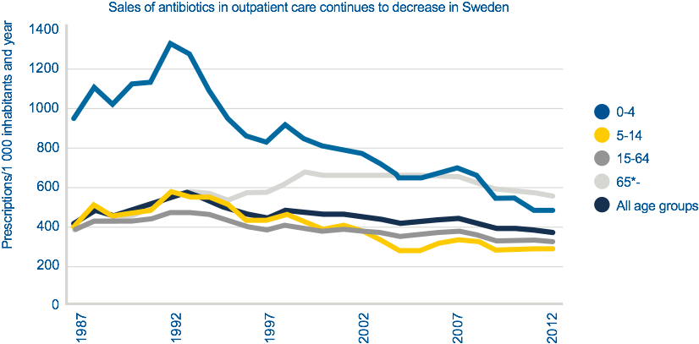
Progress
Notes:
The problem of antibiotic resistance is caused by decades of overuse. It is estimated that more than half of all antimicrobials are inappropriately prescribed or dispensed. Sweden is an exception, with one of the lowest antibiotic consumption levels in the world, partly thanks to close controls on availability and doctors who know the dangers of over-treatment.
Because of this clear link between antibiotic resistance and consumption, Sweden issued national treatment recommendations on how and when to use antibiotics. Sweden regulates sales of medicine and patients can only obtain antibiotics with a prescription issued by a licensed practitioner.
During the past two decades, antibiotic use in Sweden has been reduced by 50% in children under the age of four.
This progress has been made without producing any measurable negative results, ie., there has not been an increase in serious illnesses.
Source: Folkhälsomyndigheten
For more info: http://www.folkhalsomyndigheten.se/pagefiles/19491/Swedish-work-containment-antibiotic-resistance-brief-15003.pdf

Slide 10
A comprehensive strategy
Resources
Dialogue
Technology
Notes:
The most important reason for this positive development in recent decades is a comprehensive strategy to handle the challenge of antibiotic resistance.
This strategy has three main pillars:
We encourage an open dialogue between doctor and patient that promotes the rational use of antibiotics.
We have invested in technology to monitor the use of antibiotics in our health care system.
We allocate resources to governmental authorities to work with preventive measures.

Slide 11
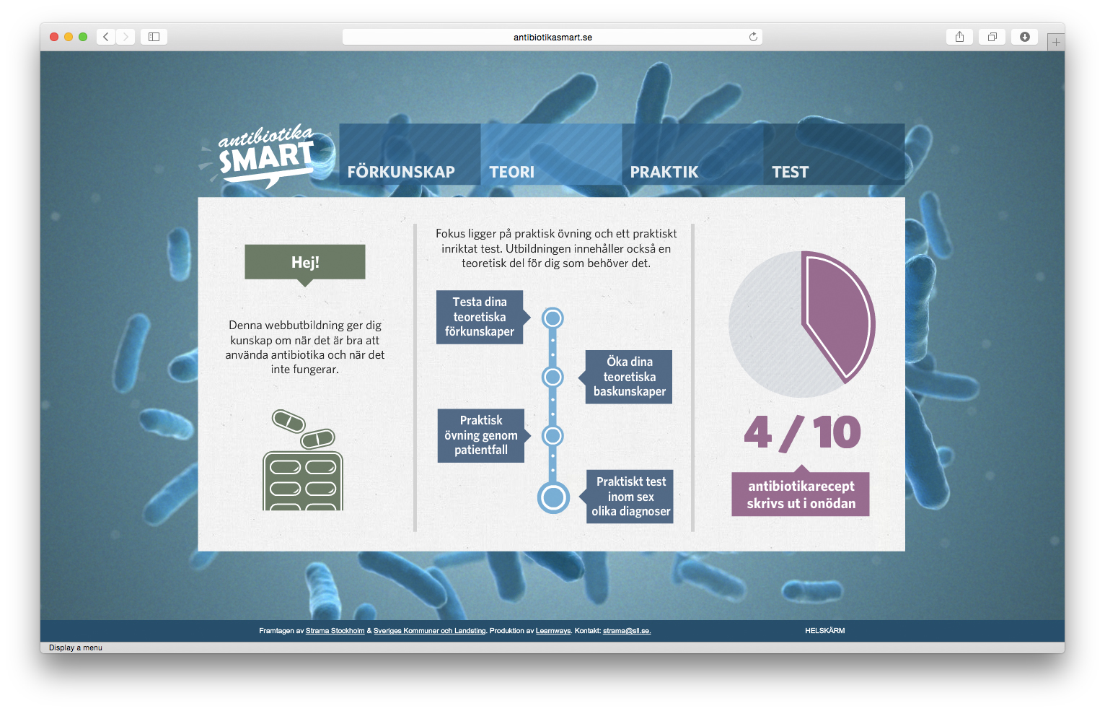
Inform & prevent
A web-based course to increase knowledge about when to use antibiotics and when not to.
Notes:
A part of this strategy is to stop people from getting infections in the first place.
Information is key to this preventive work – and so is communicating to different target groups.
Medical professionals are important, but it has also proved effective to reach new audiences through non-traditional channels.
There are also pedagogical programs such as this e-learning tool, antibiotikasmart.se. It was developed by Strama (the Swedish strategic program against antibiotic resistance) and SALAR (The Swedish Association of Local Authorities and Regions)

Slide 12



Educate & train
Notes:
Benjamin Franklin once said, “An investment in knowledge always pays the best interest.”
Quality assurance also includes the competence of the staff in the organization. The improvement of qualifications applies not only to how a medical device should be operated and maintained, but also to basic hygiene, infection control and prevention. This competence is vital for all personnel working to lower the risk of the spread of infections.
Source: Interviews with Getinge Group, Mölnlycke Health Care, Bactiguard and Hemocue (2013)

Slide 13


Aggregated data
Notes:
Another part of our strategy involves the use of aggregated data.
This is key to effective identification of resistant bacteria.
We have a system in which each individual hospital’s laboratory reports test results to a central database.
This enables us to identify patterns of potential new resistant bacteria at an early stage – and time to apply all necessary actions to stop it from spreading.

Slide 14
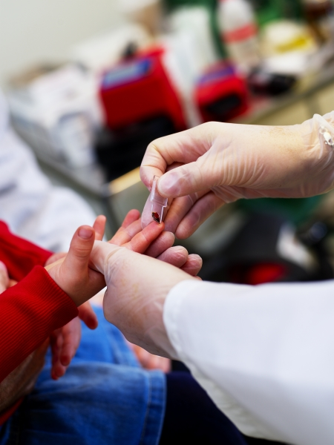
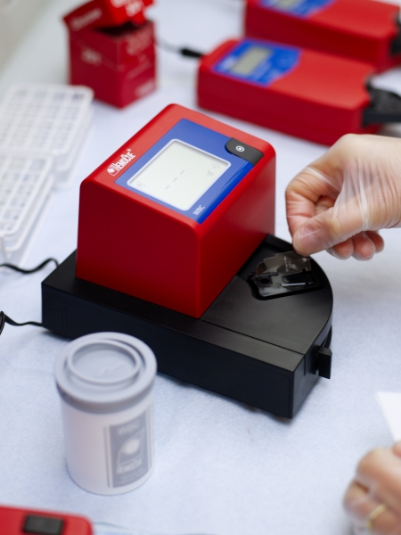
Early infection control - example
Notes:
It is commonly recognized around the world that we must work to reduce unnecessary antibiotic prescriptions for common infections. A quick and simple yet accurate white blood cell test at the point of care can help doctors decide whether to use antibiotics or not. This system is particularly well suited for regions where lab resources are not readily available since these tests are battery operated and can be operated by anyone after a short training.
Source: Interview with HemoCue

Slide 15
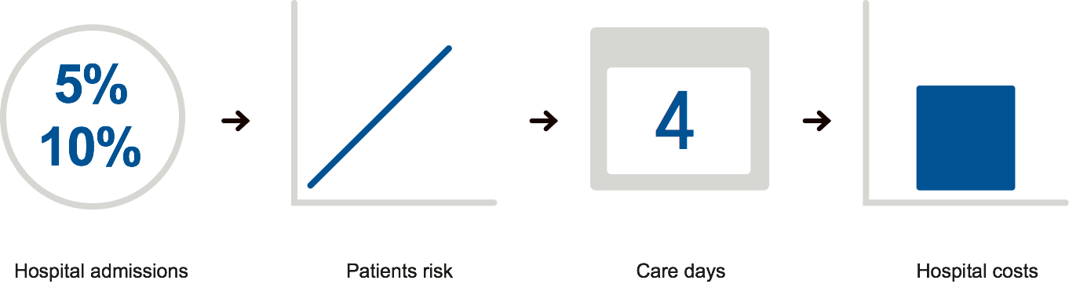
Care days / Hospital costs / Patient risk
Notes:
One EU study shows that 5-10% of all patients in European hospitals suffer from hospital acquired infections.
In general, this entails another four days of hospitalization – significantly increasing the patient’s risk and the hospital’s costs.
An effective way of avoiding these kinds of infections is to combine basic solutions with modern technologies.
Let me give you a few examples.

Slide 16


Basic solutions - example
Notes:
Many caregivers actively engage in educational campaigns to promote hygiene routines such as when and how to use disinfectants.
Especially in the prevention of hospital acquired infections, this type of simple investment is very effective, saving both lives and money.
Source: Interview Mölnlycke Health Care

Slide 17
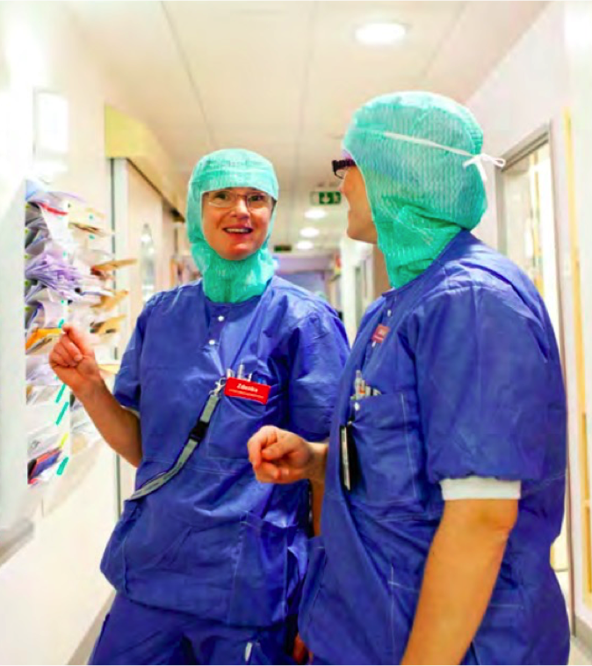
Single-use scrub suits – example
Notes:
Wearing 100 percent fresh clothing is critical to reducing the spread of bacteria. Studies show that microorganisms can survive in hospital fabrics for several months.
Single-use surgical scrub suits contribute to a hospital’s low-lint materials in a controlled environment and are meant to be worn only once.
Source: Mölnlycke Health Care

Slide 18

Unique coating on medical devices - example
Notes:
Another company has developed a thin surface layer that can be used to cover catheters and similar medical devices.
This reduces the risk of spreading bacteria and lowers the risk of, for example, urinary infection.
Source: Bactiguard

Slide 19

Safe workflow - example
Notes:
This innovative Swedish company has worked with infection control and preventative healthcare for more than 100 years.
They design entire solutions, recognizing that it takes more than equipment alone to create an effective system for disinfection and sterilization.
The result greatly reduces the risk of spreading infections and at the same time makes for smoother, more economical procedures.
Source: Getinge infection control

Slide 20


Hospital design - example
Notes:
The design of the hospital itself is another important component in preventing health care associated infections and the spread of resistant bacteria.
In Sweden we are currently building the world's most modern teaching hospital, the New Karolinska University Hospital.
Effective logistics, innovative waste management solutions and a policy of offering single rooms to patients are all important actions to prevent infections associated with health care.
Good and thoughtful design also characterizes the details at the New Karolinska University Hospital. Together with ASSA, White Architects designed the “ASSA Hygienic Handle” to limit the spread of bacteria. The handle is ergonomically designed and meets the stringent requirements of modern hospital environments.

Slide 21
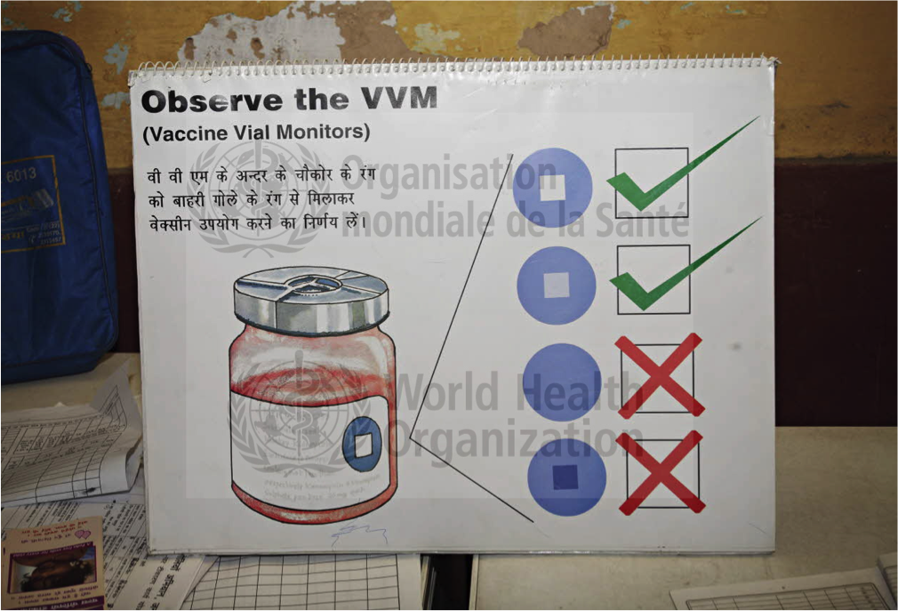
Global strategy
Improve awareness
Strengthen knowledge
Reduce the incidence of infection
Optimize the use of antimicrobial agents
Develop the economical case for sustainable investment
Notes:
The only way to stop the spread of antibiotic resistant bacteria is through collaboration. What is needed is cross-border cooperation, which is why we have been emphasizing the problem – both within the EU and globally.
Our progress in Sweden became a driving force behind the work on a global plan drawn up by WHO on the ways in which the 194 member states should work to arrest this trend.
We must safeguard the ability to treat and prevent infectious diseases using effective and safe medications. And we must ensure that antibiotics are used responsibly and made available to everyone who needs them.
The global plan has five strategic areas:
- to improve awareness and understanding of antimicrobial resistance;
- to strengthen knowledge through surveillance and research;
- to reduce the incidence of infection;
- to optimize the use of antimicrobial agents; and
- to develop the economic case for sustainable investment that takes account of the needs of all countries; and to increase investment in new medicines, diagnostic tools, vaccines and other interventions.

Slide 22
THANK YOU
www.symbiocare.org
The contents of the Symbiocare-Health by Sweden platform aim to communicate the Swedish point of view in an international context, not necessarily covering all aspects of Sweden´s public health objectives.
Notes:
Let me finish where I started.
The only way to stop the spread of antibiotic resistant bacteria is through collaboration.
Collaboration is the main reason why Sweden has one of the world's lowest levels of antibiotic consumption.
An effective way of avoiding these kinds of infections is to combine basic solutions with modern technologies.
We need to act on a global level.
We need to form international partnerships among policy makers, research institutes, health care professionals, medical industries and pharmaceutical companies.
We need to work preventively, informing and educating all stakeholders, from schoolchildren to hospital staff, health authorities and policy makers. We need collaboration and we need this for the benefit of everyone, not least the patient.
Bacteria knows no borders, but luckily, neither does a good example or solution.
Thank you for your time and for letting me share the Swedish perspective with you.

